Slide 1




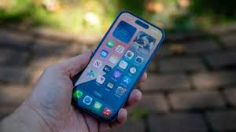
Mobile Phone Price Predictor using Machine Learning
Presented by – Aritra Mukherjee
ID: UMIP270247
Machine Learning Intern
At - Unified Mentor Pvt. Limited
Aritra Mukherjee

Slide 2
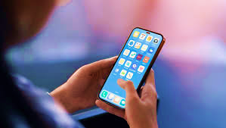
Introduction To Project –
Phone Price Predictor
In today's competitive smartphone market, price estimation based on specifications helps manufacturers, retailers, and consumers make informed decisions.
This project aims to predict the price range of mobile phones using machine learning, based on features like RAM, battery, screen size, camera specs, etc.
A user-friendly Streamlit web application allows interactive predictions.
Aritra Mukherjee

Slide 3


GOAL
Primary Objective:
To build a machine learning model that can accurately classify a smartphone into one of four price categories:
Low (₹5,000–12,000)
Medium (₹12,000–20,000)
High (₹20,000–35,000)
Very High (₹35,000+)
Secondary Goals:
Create a clean and responsive web app for predictions.
Visualize feature importance to understand key factors affecting price.
Aritra Mukherjee

Slide 4
Dataset Overview for Classification
Dataset Details:
Rows: 2000
Target: price range (0–3)
Features: 20+
RAM, internal memory, processor speed, battery power
Camera specs (front & rear)
Screen size & resolution
Connectivity features (Bluetooth, Wi-Fi, 3G, 4G, Dual SIM)
Aritra Mukherjee

Slide 5
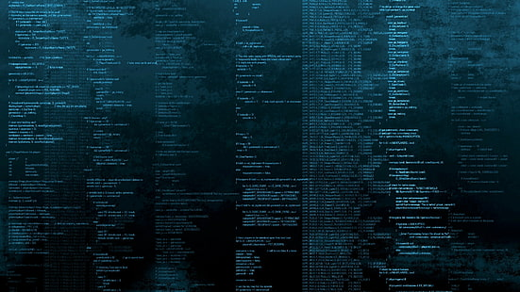
Tech Stack
Technologies & Tools Used
Languages & Tools:
Python – data processing, modelling
Streamlit – web UI for predictions
Pandas / NumPy – data handling
Matplotlib / Seaborn – visualizations
Scikit-learn – ML model, preprocessing
Pickle – saving and loading trained models
Model Used:
Random Forest Classifier
Accuracy and feature importance indicate a tree-based approach
Aritra Mukherjee

Slide 6
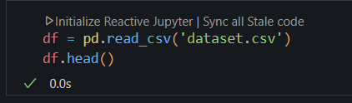
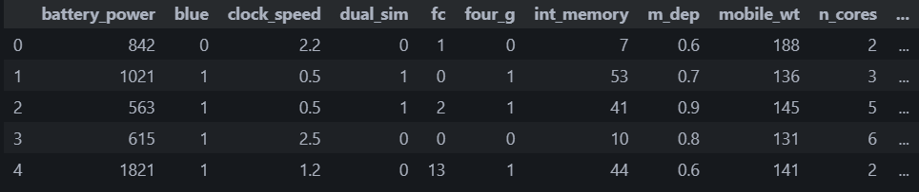
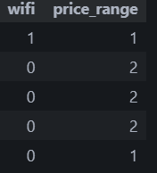
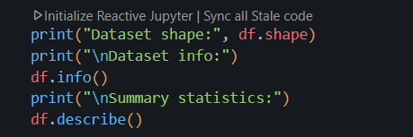
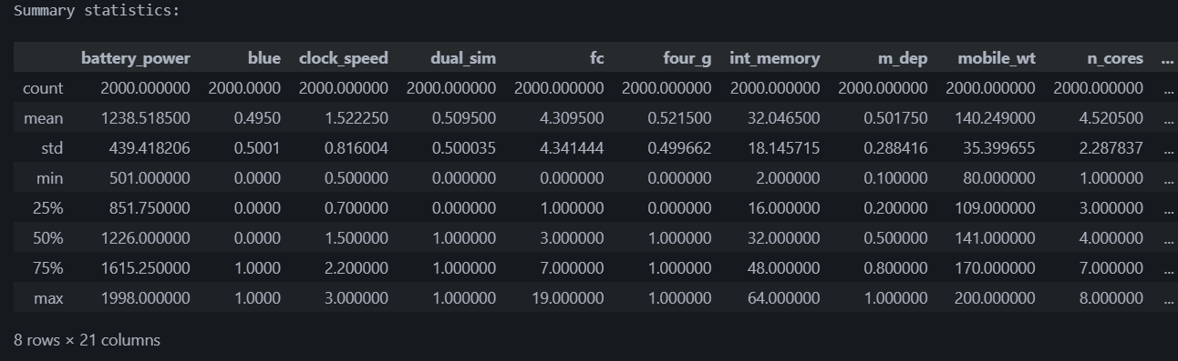
Load the Dataset
Data Exploration and Analysis
Aritra Mukherjee

Slide 7
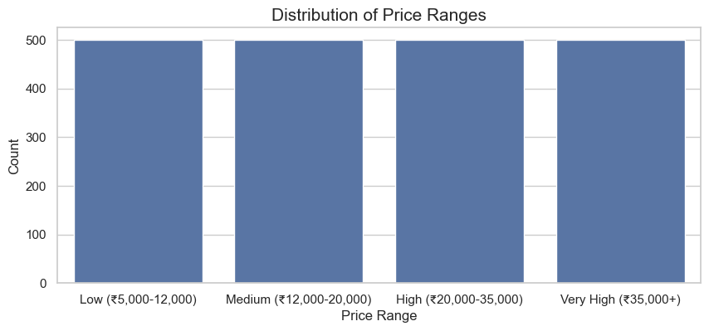
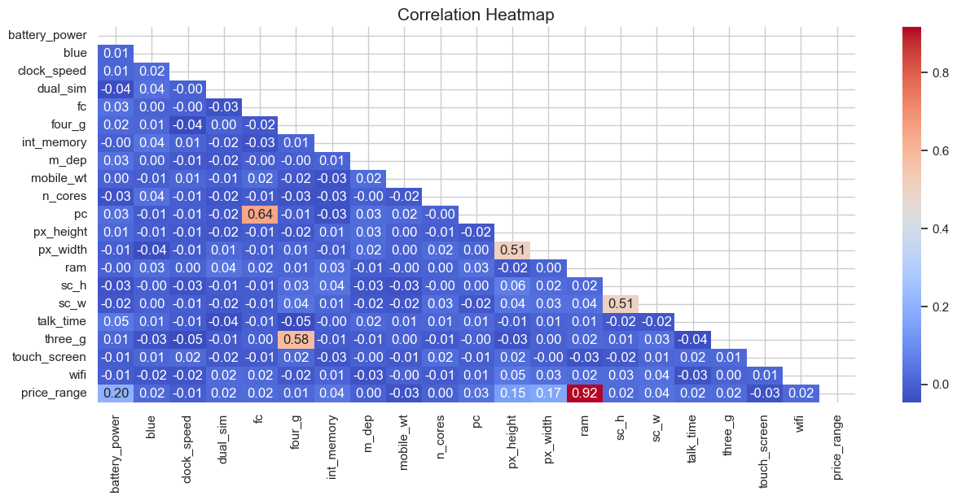
Distribution of Price Ranges
Correlation Heatmap
Aritra Mukherjee

Slide 8
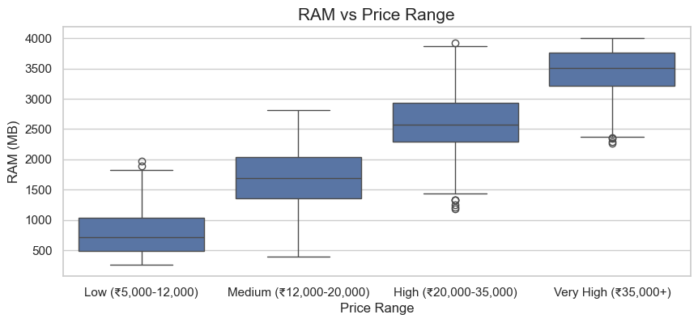
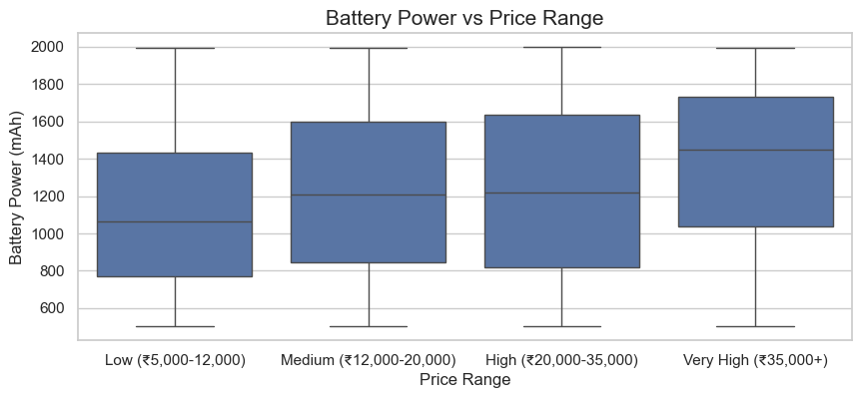
RAM vs Price Range
Battery Power vs Price Range
Aritra Mukherjee

Slide 9
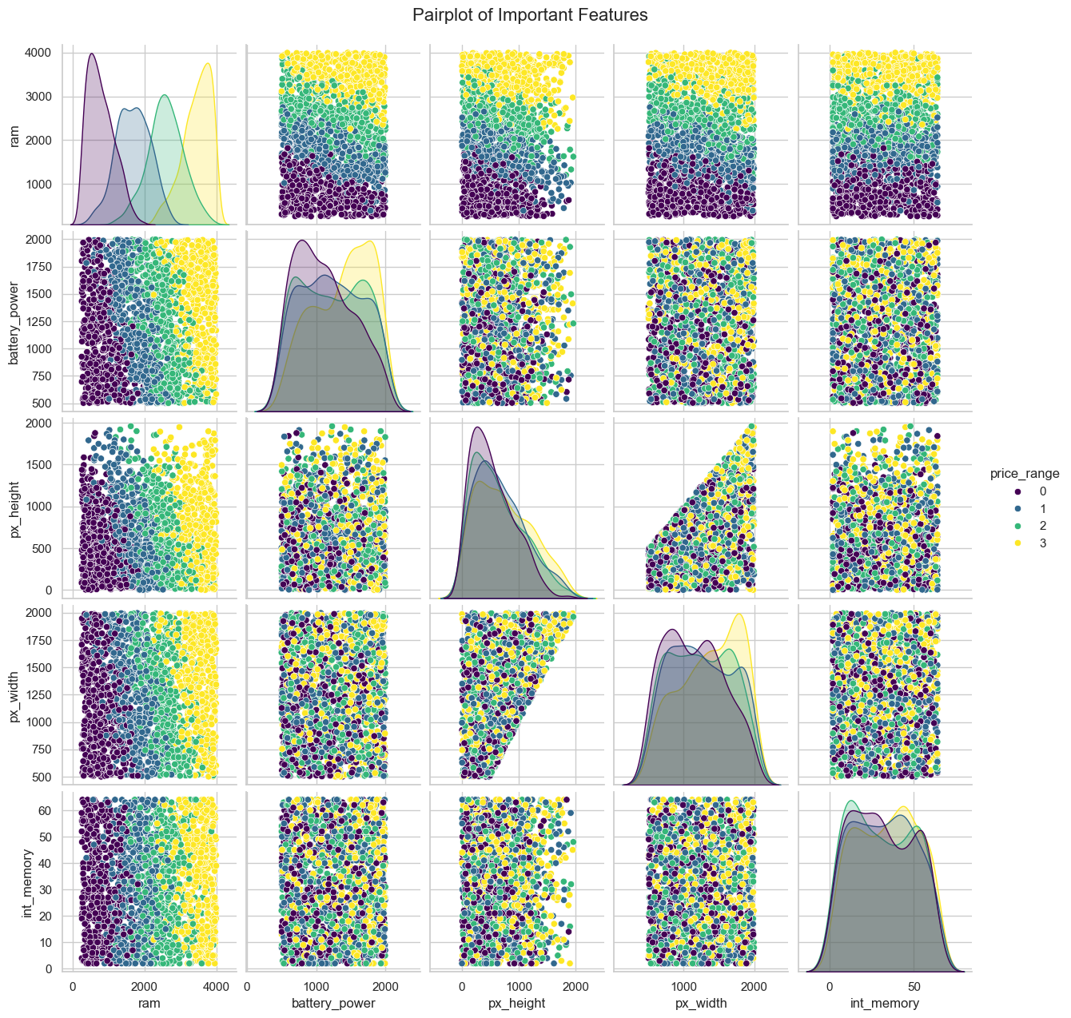
Pair plot of Important Features
Aritra Mukherjee

Slide 10
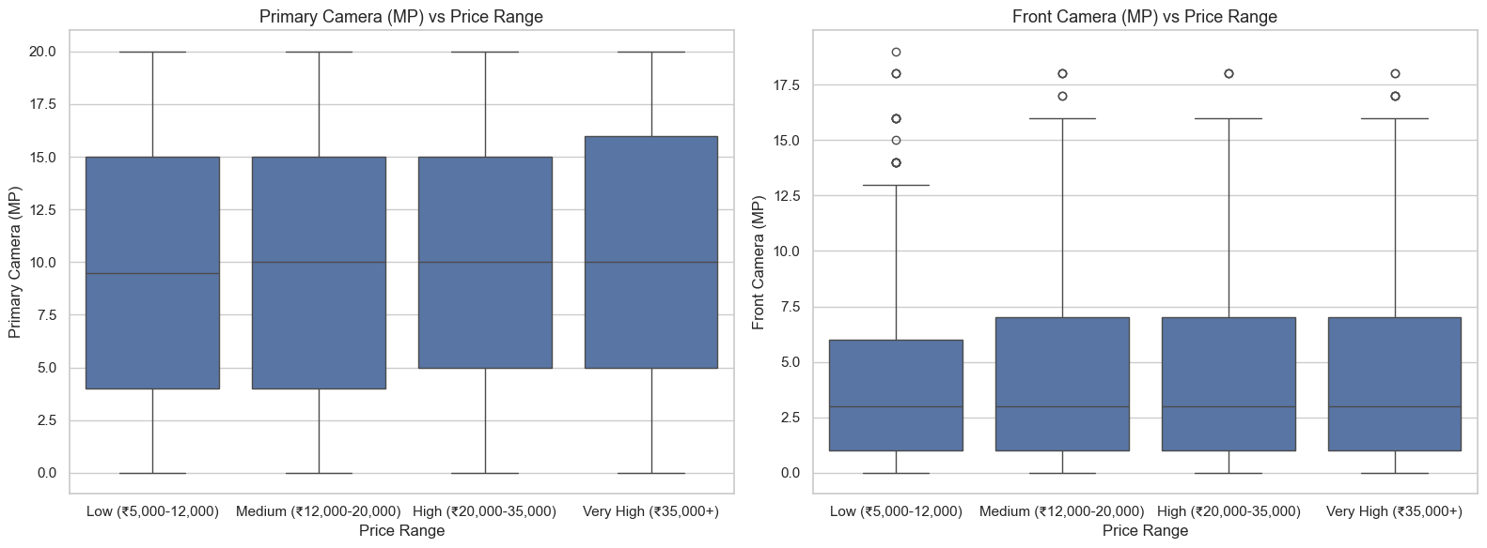
The Price Different b/w Primary Camera (MP) & Front Camera(FC)

Slide 11
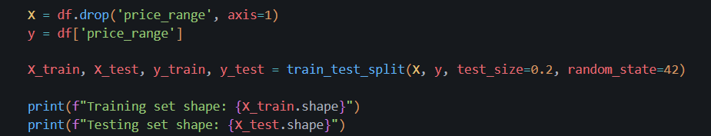

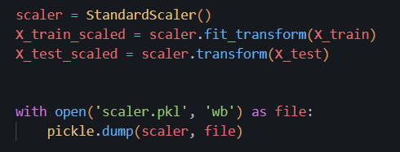
Feature Selection and Preprocessing

Slide 12
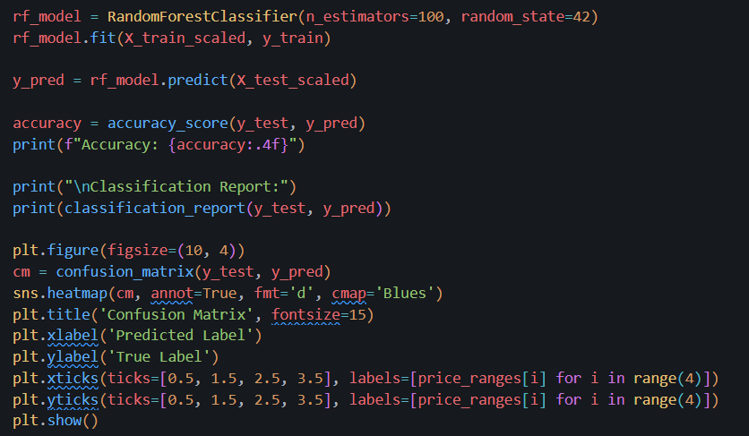
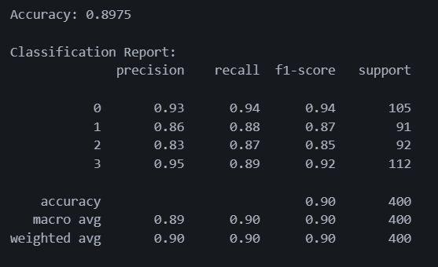
Model Training and Evaluation
Accuracy – 89.75%
Aritra Mukherjee

Slide 13
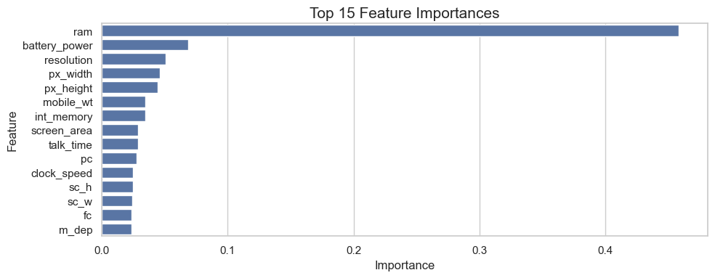
Top 15 Feature Importances
Save the Trained Model
Aritra Mukherjee

Slide 14
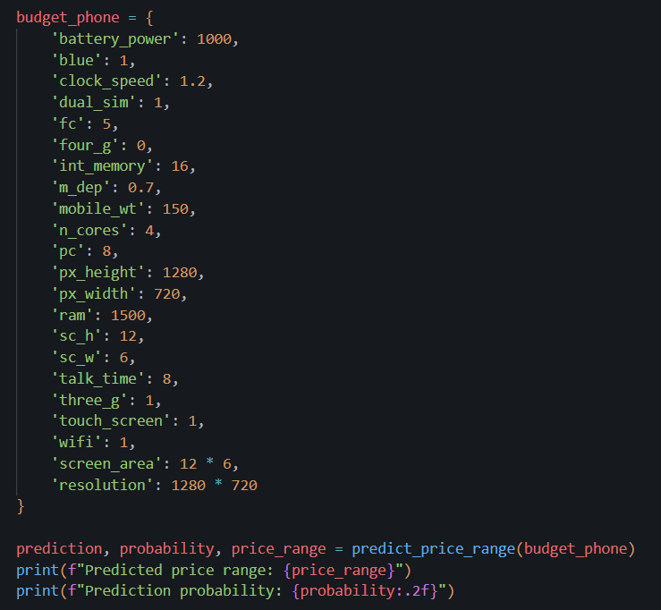

Model Testing with Sample Data
Aritra Mukherjee

Slide 15
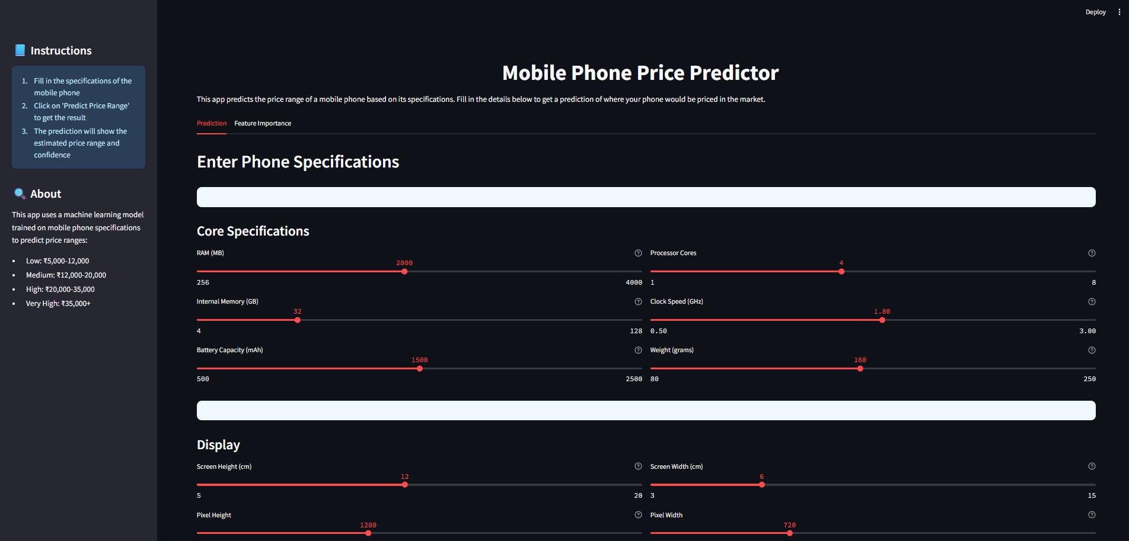
Prediction
Aritra Mukherjee

Slide 16
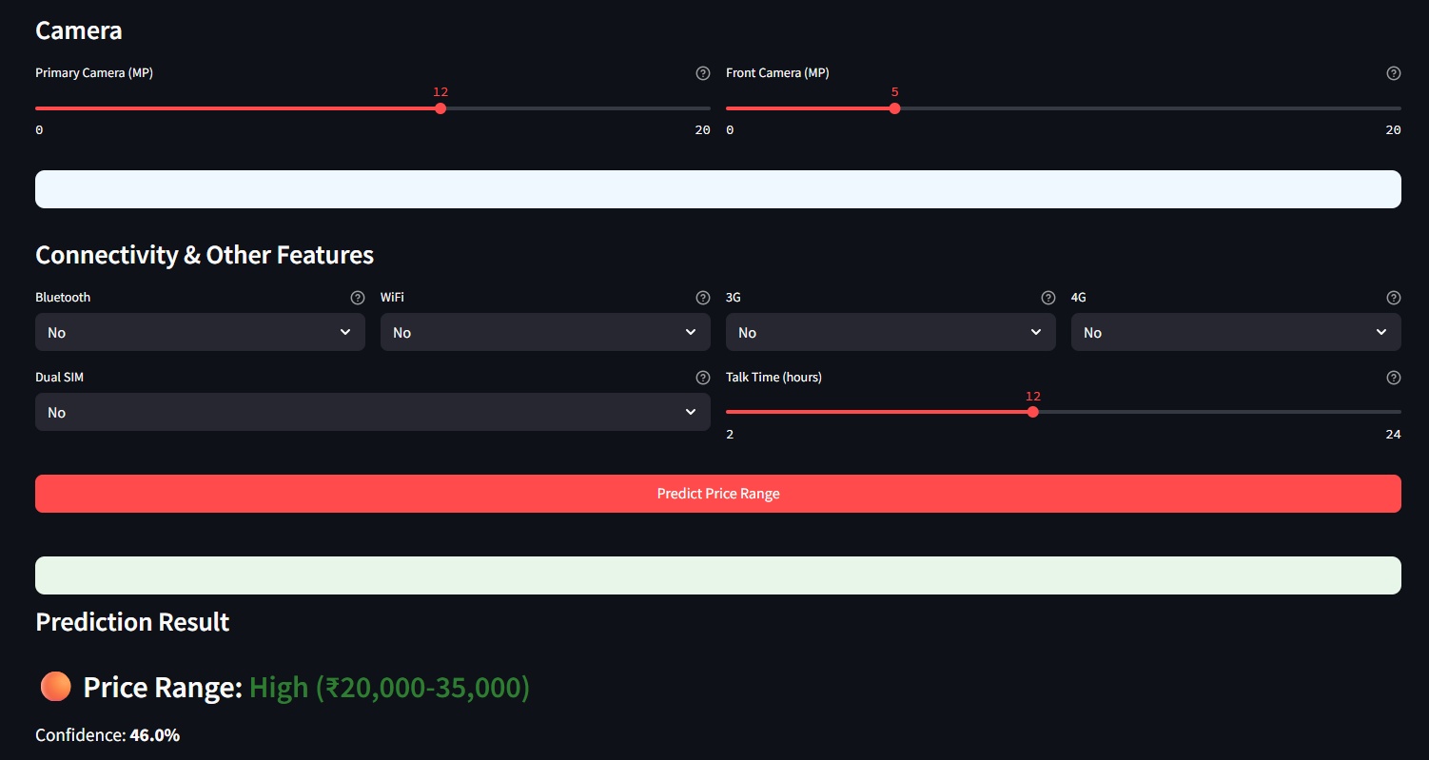
Prediction
Aritra Mukherjee

Slide 17
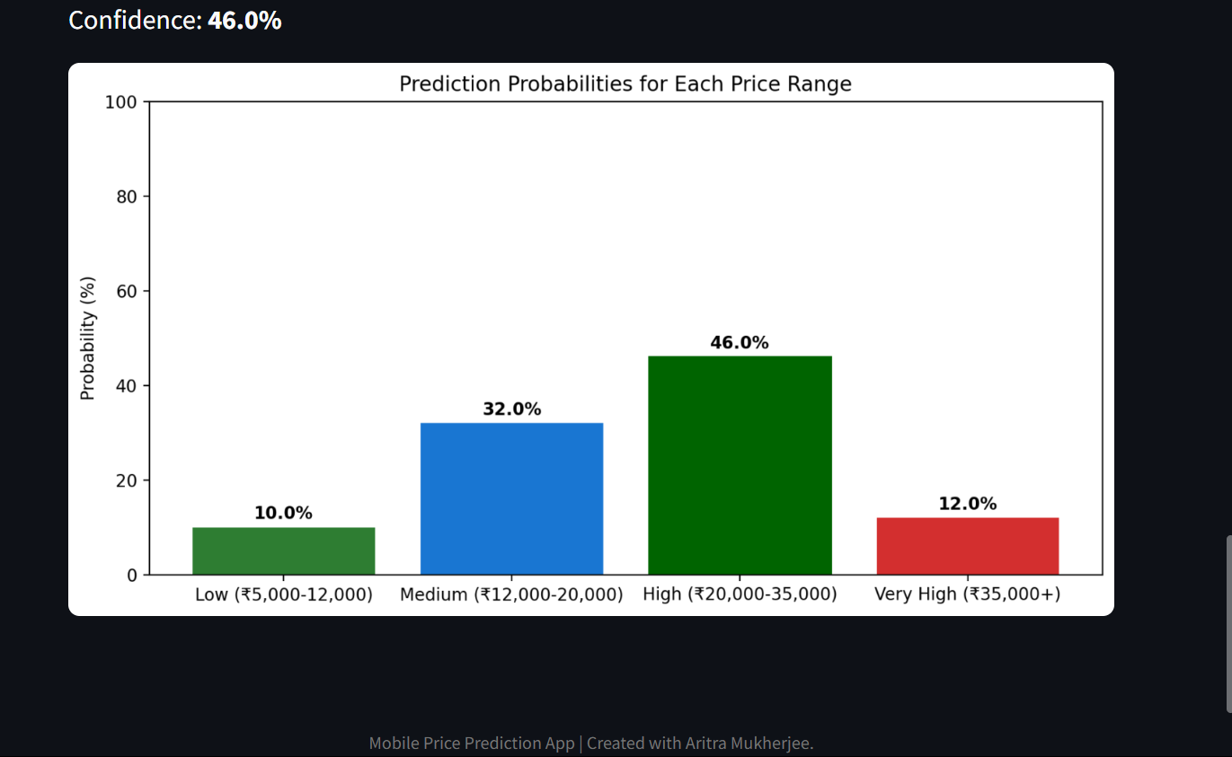
Prediction
Aritra Mukherjee

Slide 18
Deploy Using Hugging Face Space
Live Demo -
Mobile-Price-Predictor-ML-App
Aritra Mukherjee

Slide 19
Conclusion
Successfully developed an interactive ML-based app for smartphone price prediction.
Achieved clear classification of phones into pricing tiers based on hardware features.
Enables practical use in e-commerce, retail analysis, or product planning.
Aritra Mukherjee

